Slide 1
“Civil Registry System” (8th Semester Industrial Project)
Palak Agarwal
CSE – B - 090

Slide 2
Objective & Scope
It is a system by which a government records the vital events of its citizens. The resulting repository or database is called civil register or registry, or population registry.
The main purpose of the web site is to reduce the effort by the candidate and save his time avoiding unwanted rushes at the government offices.
These establish the occurrence of birth, death, or marriage and therefore provide prima facie evidence of facts surrounding these events.
The primary objective of this web site is to give awareness about the government or legal documents and its registration details as well as to help to register or apply for those documents.
The secondary purpose is to create a data source for the compilation of vital statistics.

Slide 3
Need Of the Project – Why ?
Countries need to know how many people are born and die each year – and the main causes of their deaths – in order to have well-functioning health systems.
Countries that do not have a well-functioning civil registration system only have approximate ideas of the numbers, the longevity and the health of their population.
Even to search for a person there should be a proper database with which we can keep a track of the citizens in a country.
The only way to count everyone and to track all births and deaths is through civil registration.

Slide 4
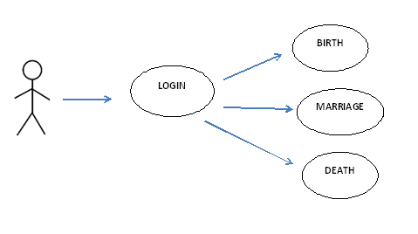
Synopsis of the Project

Slide 5
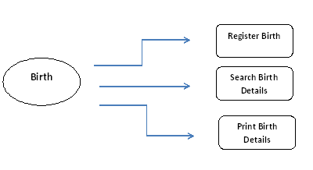
Synopsis of the Project…
Same with Marriage and Death Portals

Slide 6
Requirement Specifications
Software - Eclipse IDE
Database - HeidiSQL
Server - Apache Tomcat
Programing Languages - Java , JSP,
HTML, CSS

Slide 7
Civil Registry Law
According to the Act No. 3753,
Civil Registry is a continuous, permanent and compulsory recording of vital events occurring in the life of an individual such as birth, marriage, and death, as well as court decrees, and legal instruments affecting his civil status in appropriate registers.

Slide 8
Salient Features of the Project
Among the legal documents that are derived from civil registration are birth certificates, death certificates, and marriage certificates. Civil registration brings multiple benefits.
An individual’s right to be counted at both extremes of life is fundamental to social inclusion.
In the absence of insurance or inheritance, death registration and certification are often required prerequisites for burial, remarriage, or the resolution of criminal cases.
For health agencies like WHO, civil registration systems are the most reliable source of statistics on births and deaths, and causes of death.
Civil registration is the way by which countries keep a continuous and complete record of births, deaths and the marital status of their people.

Slide 9
Constraints of the Project
Countries that do not use national citizen identification numbers would find it far more difficult to create a civil registry with a high level of currency, accuracy and completeness.
If the ministry responsible for maintaining the civil registry is either unwilling or unable to keep it current, accurate or complete to acceptable, pre-determined standards, the authority is forced to start with poor data as the basis for the citizen’s welfare.
The project Civil Registry still requires more development of IT solutions and its applications to improve the issuance of copies of government certificates and legal documents. Civil registry team is trying to get more affiliation to government offices and departments.

Slide 10
Outcome Expected of the Project
Mechanism of Registration of Birth , Marriage and Deaths of Citizens in a Country.
Availability of Country Wide Data.
Uses of proper Stats for the Welfare Schemes.
Scientific Way of Monitoring & Analysis towards Development of the Projects.
Transparency in operations of Registration.
Government Official Record brings Fair & Justice for Citizens.

Slide 11
Thanks

